Slide 1
Problem set 6 walkthrough
February 26, 2020

Slide 2
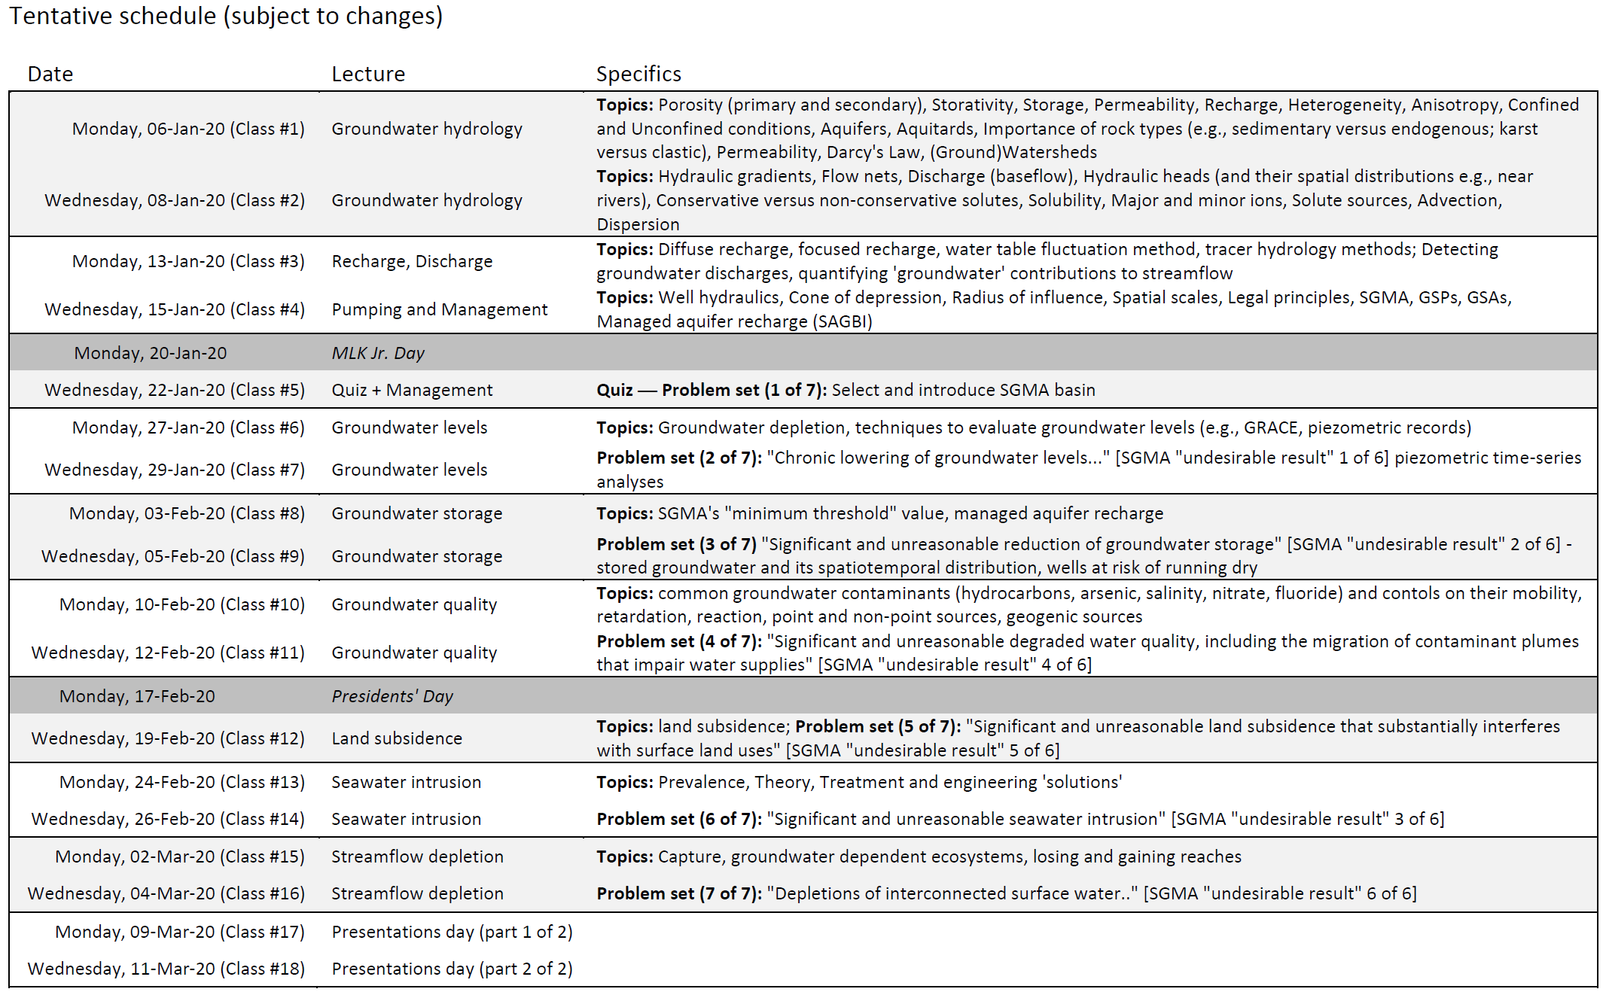

Slide 3
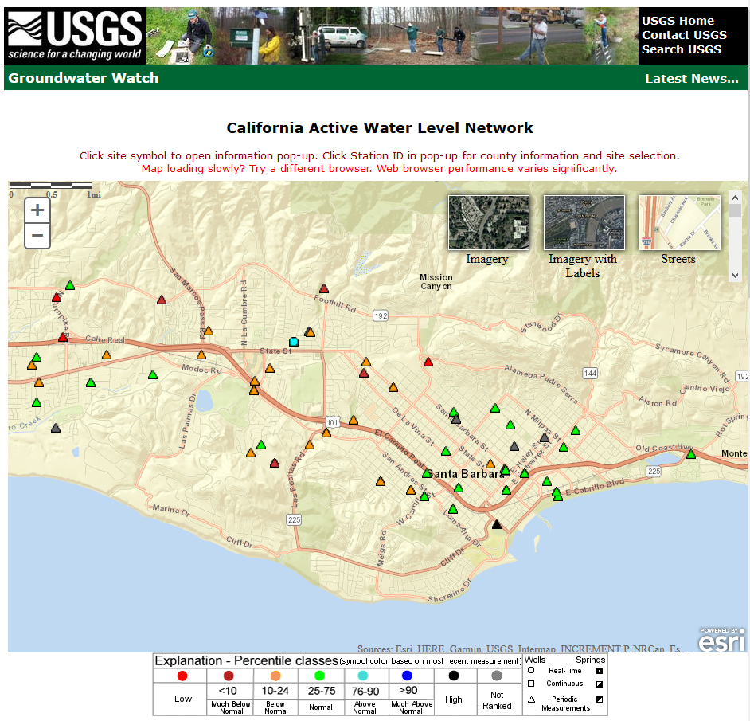
Question 1 – santa Barbara well water levels
Data available at: https://groundwaterwatch.usgs.gov/StateMap.asp?sa=CA&sc=06

Slide 4
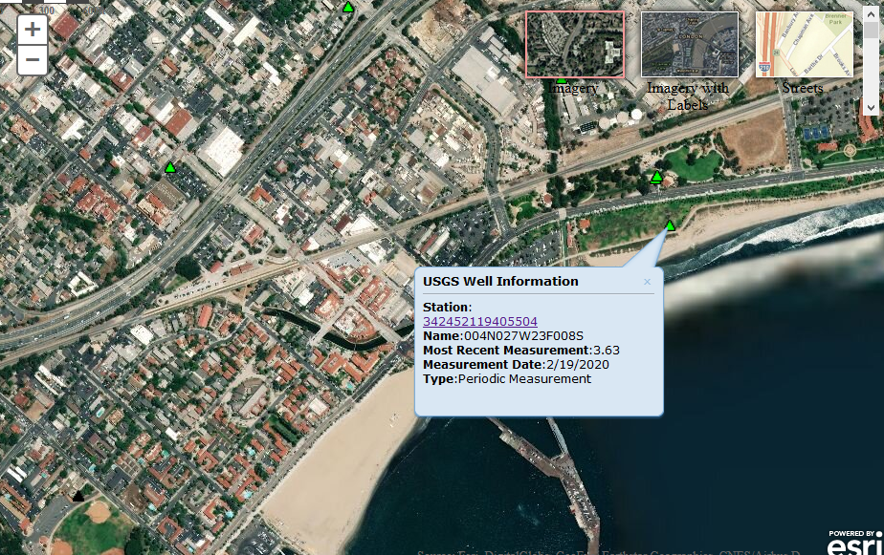
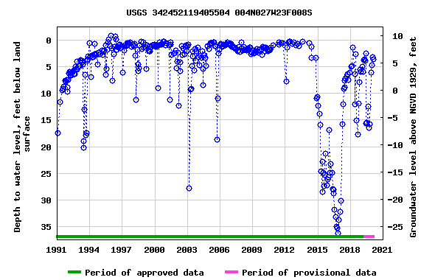
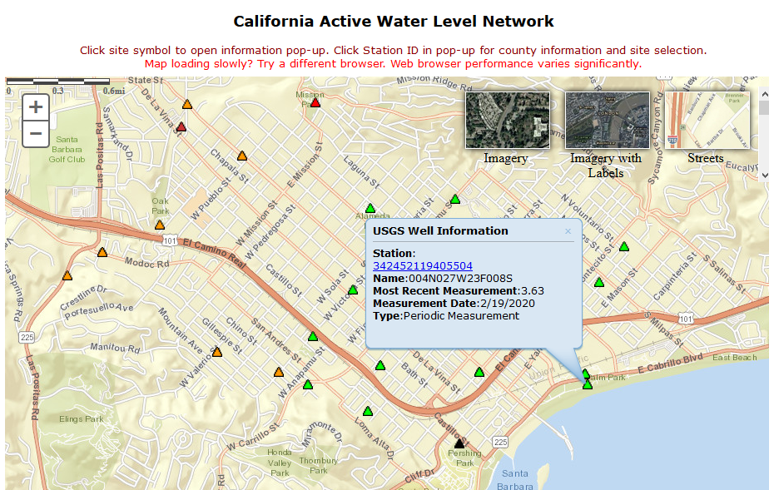
USGS 342452119405504 004N027W23F008S
Santa Barbara County, California
Hydrologic Unit Code 18060013
Latitude 34°24'52.0", Longitude 119°40'59.8" NAD83
Land-surface elevation 9.56 feet above NGVD29
The depth of the well is 430 feet below land surface.
The depth of the hole is 438 feet below land surface.
This well is completed in the California Coastal Basin aquifers (N100CACSTL) national aquifer.

Slide 5
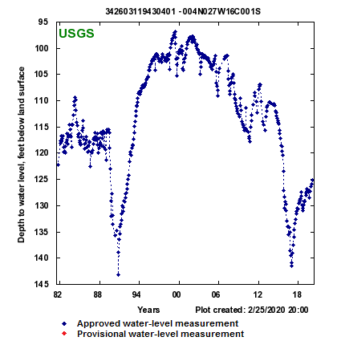
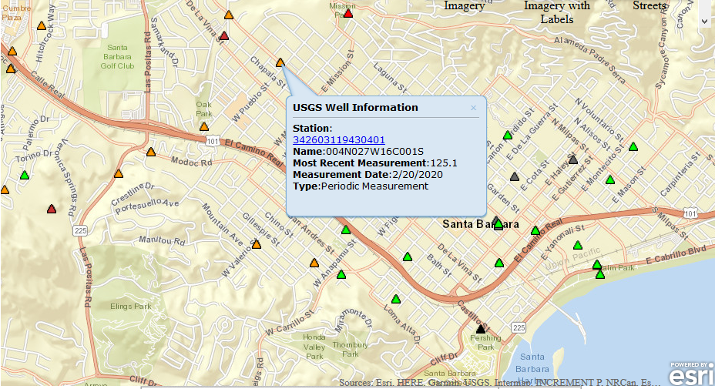
342603119430401 - 004N027W16C001S
Latitude 34°26'02.1", Longitude 119°43'07.9" NAD83
Santa Barbara County, California, Hydrologic Unit 18060013
Well depth: 330 feet
Hole depth: 360 feet
Land surface altitude: 210.00feet above NGVD29.
Well completed in "California Coastal Basin aquifers" (N100CACSTL) national aquifer.

Slide 6
Data download
https://www.waterqualitydata.us/portal/#siteType=Well&pCode=70301&mimeType=xlsx
Must download “Sample results (phys/chem)” separately from station data
I deleted n=26,552 measurements where no data were available for either hole depth or well depth. Well depth data were used where available; where these data were unavailable the hole depth was used as a proxy for the well depth (accepting that doing so introduces some uncertainty as to the actual depths of wells in the resulting compiled dataset). I retained only the most recent measurement in the dataset (i.e., if more than one TDS measurement exists for a single well, I deleted earlier measurements and kept the most recent TDS measurement)

Slide 7
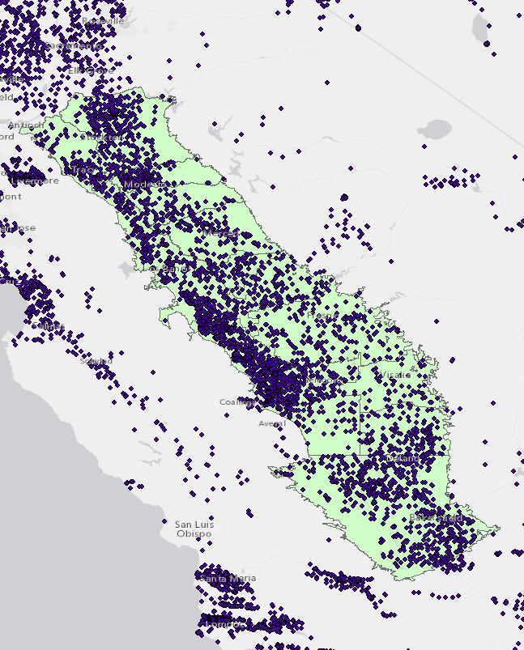
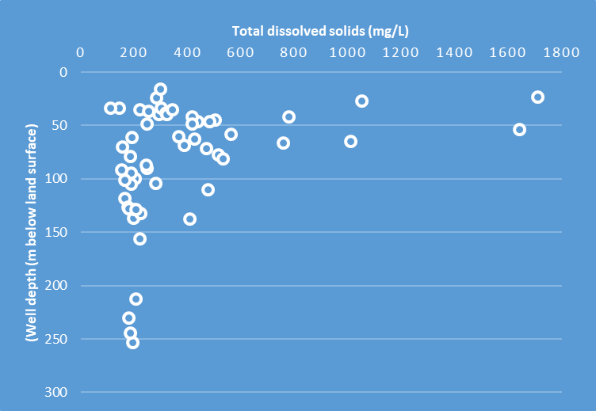
Your sgma basins and tds measurements
Plot total dissolved solids (in mg/L) versus well depth for your basin

Slide 8
TDS and drinking water standards
For secondary drinking water standard information see: https://www.epa.gov/sdwa/secondary-drinking-water-standards-guidance-nuisance-chemicals
Basin | Count
KAWEAH | 65
WESTSIDE | 796
KINGS | 252
CHOWCHILLA | 55
MADERA | 122
MERCED | 176
MODESTO | 157
TURLOCK | 129
DELTA-MENDOTA | 493
TRACY | 122
EASTERN SAN JOAQUIN | 355
KERN COUNTY | 631
TULARE LAKE | 130
TULE | 178

Slide 9
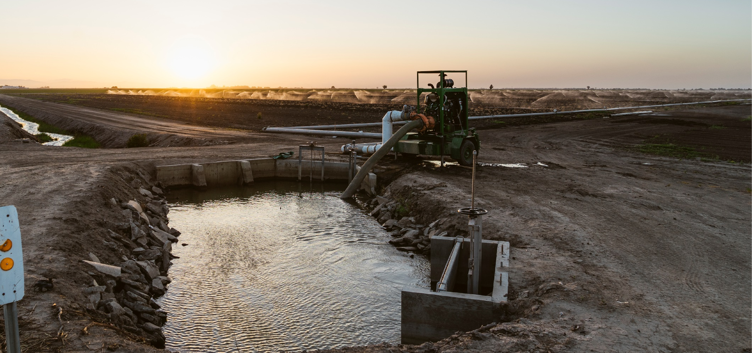
Problem set 6
photo by Chad Ress (chadress.com)

